Slide 1
BIENVENIDOS A LA CLASE DE ESPAÑOL
Señora Barnett
monica.barnett@polk-fl.net
Barnettmspanish1.weebly.com

Slide 2
Behavior Expectations
Each student is expected to…
Ask for permission to leave his/her seat.
Raise his/her hand for comments or questions.
Come to class prepared.
Be attentive and treat self and others with respect.
Be on time for class.
Not use electronic devices without permission.
Not wear earphones or headphones without permission.
Exhibit the characteristics of an IB learner.
School policy will be enforced when exhibiting unacceptable behavior.

Slide 3
CELL PHONES, I-PHONES, CAMERAS, AND OTHER ELECTRONIC / WIRELESS DEVICES including Apple type Watches: Unless otherwise instructed by Mrs. Barnett, Cell Phones, Smart Phones (etc.) are not to be turned on or used in our classroom and should remain out of sight (in your book bag if you have one). Also, earbuds or headphones are not allowed to be worn or used at any time in the classroom.
Note#1: STUDENTS MUST RECEIVE PERMISSION FROM A TEACHER TO PHOTOGRAPH,
AUDIO-RECORD OR VIDEO-RECORD THAT TEACHER AT ANY TIME DURING SCHOOL.
Note#2: Students do not have permission to charge any electronic device in the classroom any time.
Note#3: If a student has an electronic device out during any assessment (test, quiz, etc.) grade = Zero.

Slide 4
During this year, students are expected to expand their knowledge of Spanish through three major blocks: vocabulary, the grammar, and the practice of communication in the context of the “travels” to different Hispanic countries and the challenges.
Santillana Español I, the new adopted textbook provides students with diverse and meaningful activities that will allow them to communicate effectively in the target language.
The year will be based on following four pairs of enthusiasts of the Spanish language as they explore the Spanish-speaking world.
Level 1 has activities which aim to motivate the students and promote independent work. Florida’s history, population, and culture have a strong presence in these new textbook.
By the end of the year, it is expected that students will be better prepared to have real life conversations with Spanish-speaking members of their communities and also appreciate and respect their culture

Slide 5
Materials Needed:
Mrs. Barnett’s Spanish Class
Composition book
Highlighters
Notebook paper
Plastic folder (3 prongs/2 pockets)
Sheet protectors
Pencils/pens
Book to read
Optional: pencil sharpener

Slide 6
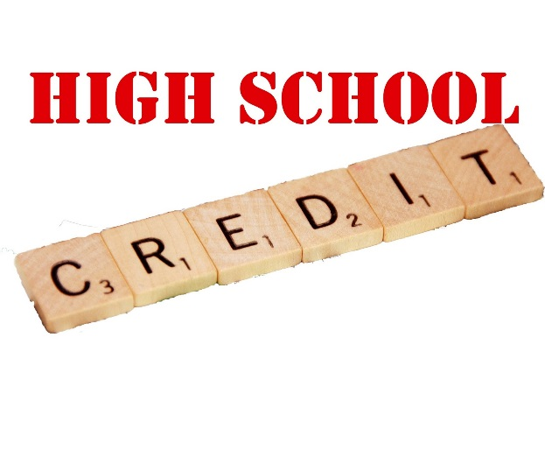
High school credit
A high school credit is awarded to students upon completion of this course.
All students enrolled in a credit-bearing course must maintain a cumulative average of 75% or higher.
For students who remain in World Language 1, it is mandatory to take midterm and a final exam.

Slide 8
Frequently asked questions
Z in the gradebook means the assignment can be made up
No extra credit
Schedule an appointment with office for a conference
Extra help is available
Daily classwork and homework are written in agenda

Slide 9
Study tips
Study notes and vocabulary often.
Speak Spanish as much as possible, even to yourself.
Explore opportunities to practice listening to Spanish.
Study with a friend, maybe even someone who is a native speaker.
Be patient.
Don’t expect to be perfect.

Slide 10
Online Resources
Quia.com
Quizlet.com
Kahoot
Quizziz
Studyspanish.com
Spanish123

Slide 11
Contact Information
Lawton Chiles Middle Academy
Teacher: Sra. Barnett
Class: Español I and 7th grade Spanish
E-mail me at monica.barnett@polk-fl,net

Slide 12
7th grade: Remind@eak66e
8th grade: Remind @fgf6b

